Slide 1
Introduction to Human Computer Interaction
Week 1, Unit 1
CC7 Human Computer Interaction
Lovely Jenn A. Reformado

Slide 2
Table of Contents
What is Human Computer Interaction?
Four Components of Human Computer Interaction

Slide 3
Introduction to Human Computer Interaction
What is HCI? | Examples of Technologies | Technologies: Good v. Bad | Why HCI?

Slide 4
What is Human Computer Interaction (HCI)?
Multidisciplinary field of study on the design of computer technology and interaction between humans and computers
Concerned with the physical, psychological, and theoretical aspects of the processes
Has since expanded to cover almost all forms of information technology design

Slide 5
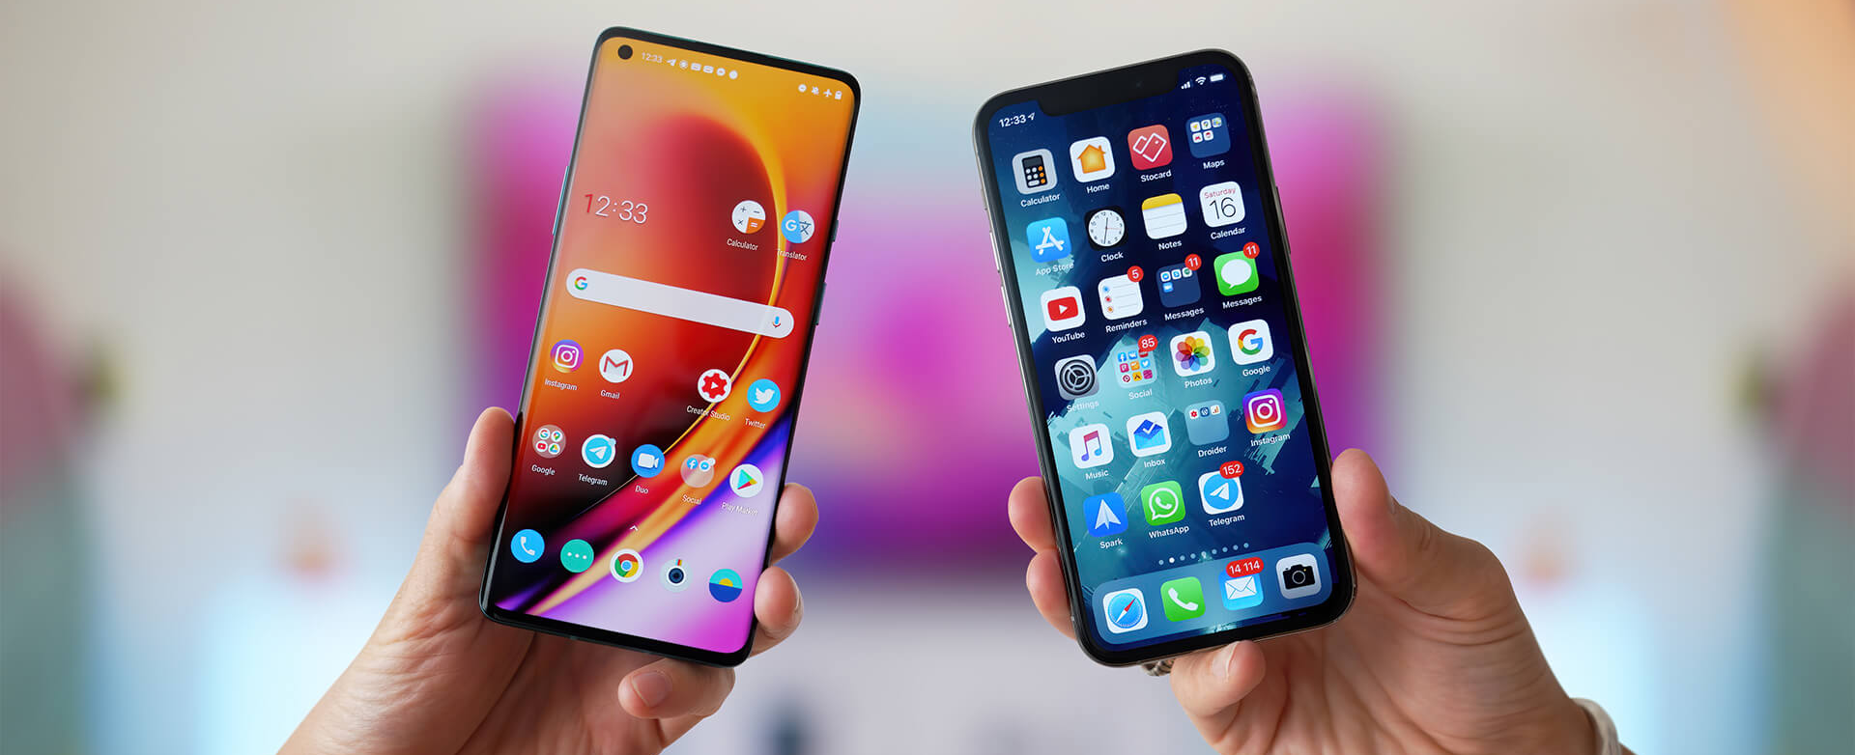
Examples of Technologies

Slide 6
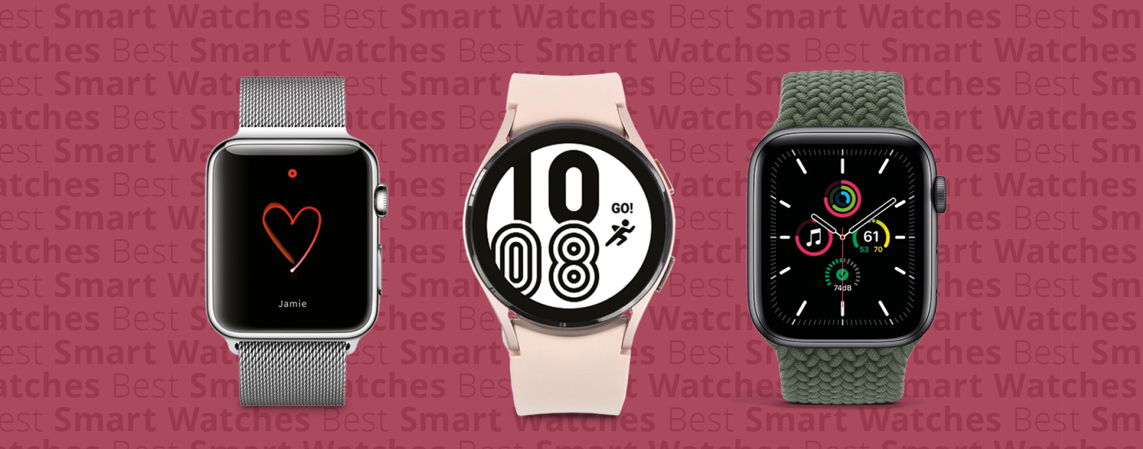
Examples of Technologies

Slide 7
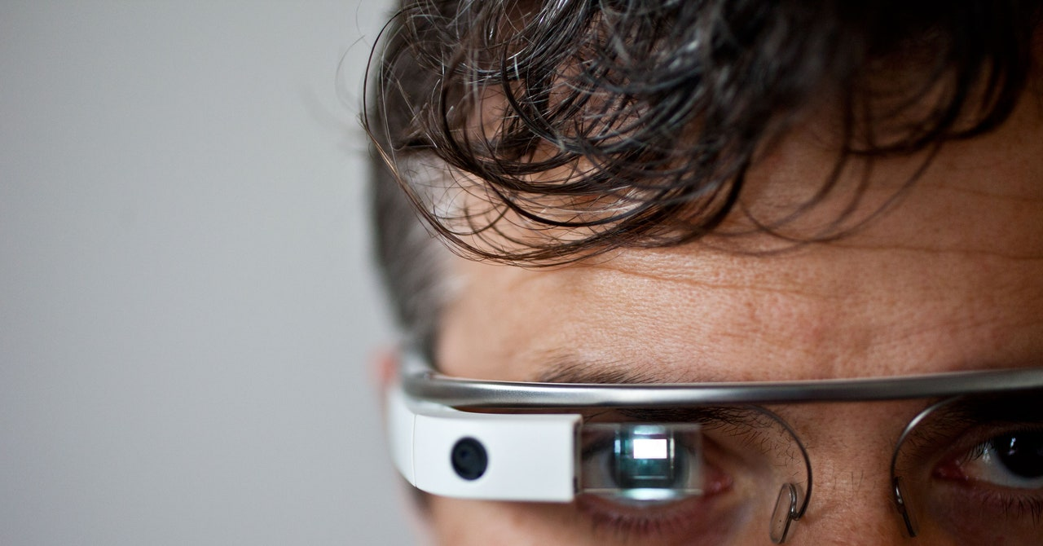
Examples of Technologies

Slide 8

Examples of Technologies

Slide 9
Technologies: Good v. Bad
Is good or bad the right question?
What makes a technology good or bad?
How can we build good technologies?
How can we verify or validate the goodness of our technologies?

Slide 10
Why HCI?
Errors / mistakes in computer technologies still exist today
Focus on whether or not the technology works
The concept is too cool / groundbreaking
Functions are hard to utilize / process
Specific people use things specifically
Too much safety / security in the technology
Too much focus on the design

Slide 11
Why HCI?
When creating technologies, it must be:
Suitable for the task
Easy to use
Adaptable to the user’s knowledge and experience
Provides feedback on the performance
Displays information in a format and pace understandable to the user
Conforms to the principles of software ergonomics

Slide 12
Why HCI?
The idea of use is also necessary for HCI:
Useful – accomplish what is required (play music, cook dinner, format a document)
Usable – do it easily and naturally, without danger of error
Used – make people want to use it, be attractive, engaging, fun

Slide 13
Four Components of HCI
Human | Computer | Interaction | Context

Slide 14
Four Components of HCI
Human
Computer
Interaction
Context

Slide 15
The Human
Also known as the user / end-user
Limited in their capacity to process information
Has important implications for design
Focuses on who the HCI is for

Slide 16
The Human
Information is received and responses given via several input and output channels:
Visual
Auditory
Haptic channel
Movement

Slide 17
The Human
Information is stored in memory
Sensory memory
Short-term (working) memory
Long-term memory

Slide 18
The Human
Information is processed and applied:
Reasoning
Problem solving
Skill acquisition
Error

Slide 19
The Human
Emotion influences human capabilities
Users share common capabilities but are individuals with differences

Slide 20
The Computer
Focuses on where the HCI is found
Comprises various elements, each of which affects the user of the system
Input devices
Output display
Virtual reality systems
Various displays (physical controls, haptic dieback, sensors)
Paper output and input
Memory
Processing

Slide 21
The Interaction
Interaction models help us to understand what is going on in the interaction between user and system
Address the translations between what the user wants and what the system does
Focuses on what the HCI is

Slide 22
The Interaction
Ergonomics are physical characteristics of the interaction and how these influence its effectiveness
Dialog between user and system is influenced by the style of the interface
Interaction takes place within a social and organizational context that affects both user and system

Slide 23
The Context
Also known as paradigms
Examples of effective strategies for building interactive systems to design usable interactive systems
Focuses on how the HCI will be formed
Ranges from the introduction of timesharing computers, through the WIMP and web, to ubiquitous and context-aware computing

